Slide 1

Amazon’s Top 50 Selling Books from 2009 – 2019 Analysis
Alex Cheung

Slide 2






Background
Amazon is one of the largest online marketplaces for purchasing books.
In this analysis, we observe data about their top 50 bestsellers from 2009-2019.
Fiction
Non Fiction
Catalog of Books
Research Questions:
1. What effect does genre have on the sale price of non fiction books versus fiction books?
2. How does the price of books vary over time?

Slide 3




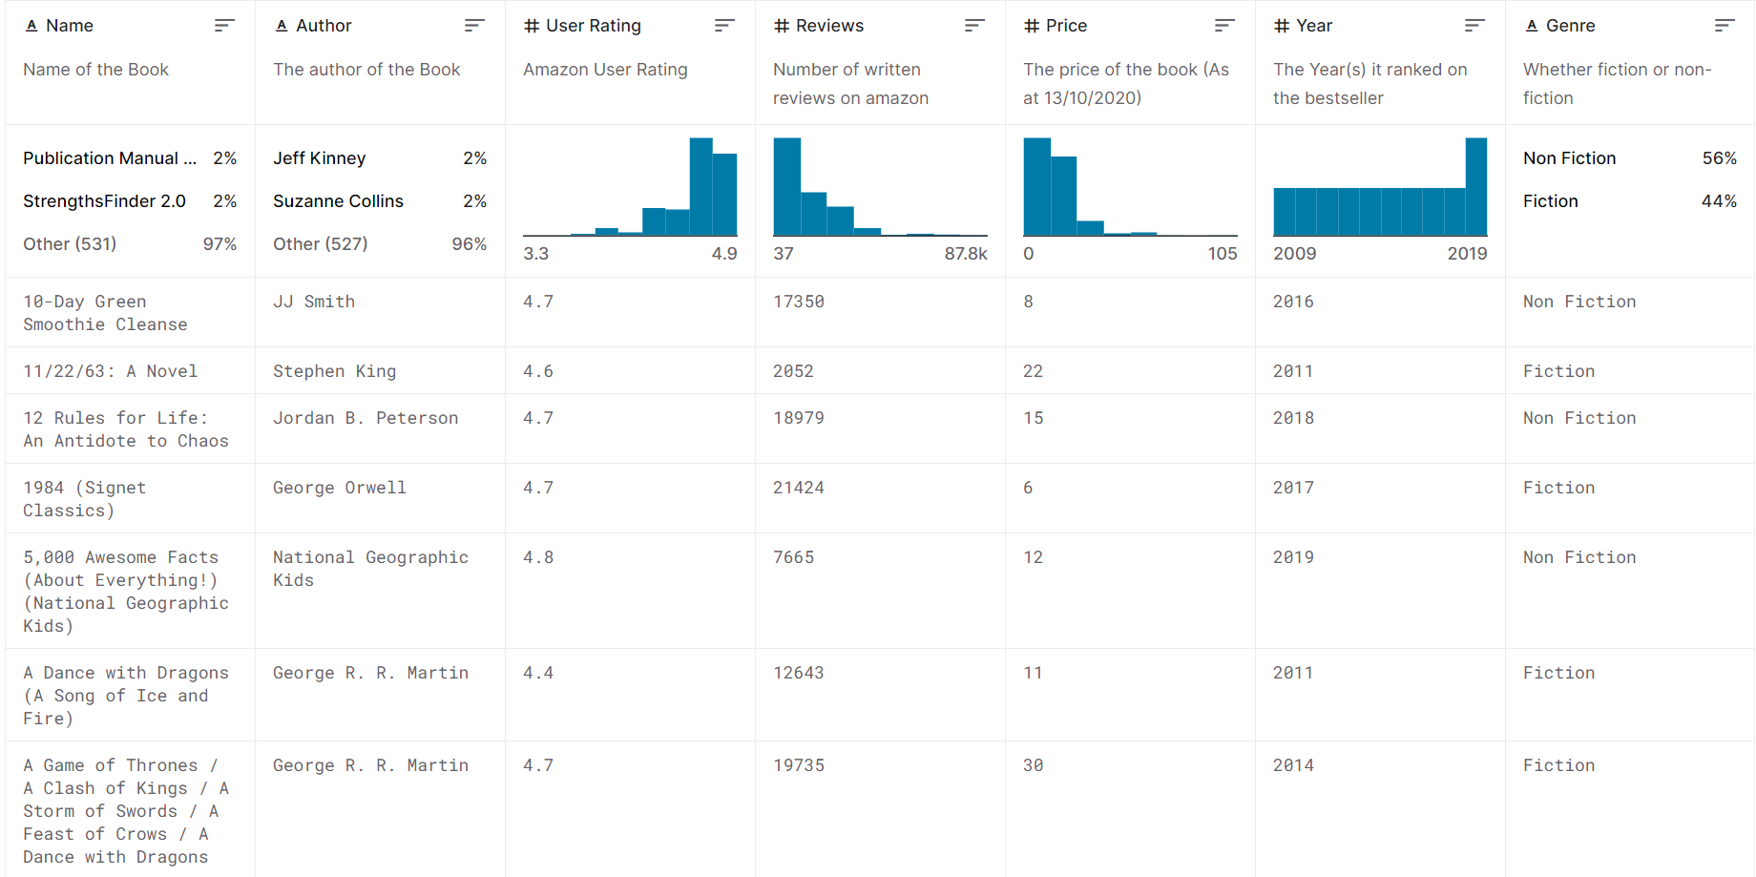


Methods
1. Find a Dataset
2. Data Analysis
3. Data Visualization
Use Kaggle to find a dataset
Clean the data using R
Find significant relationships
p < .05
Inspect the data
EDA: Distributions and correlations
Visualize results

Slide 4
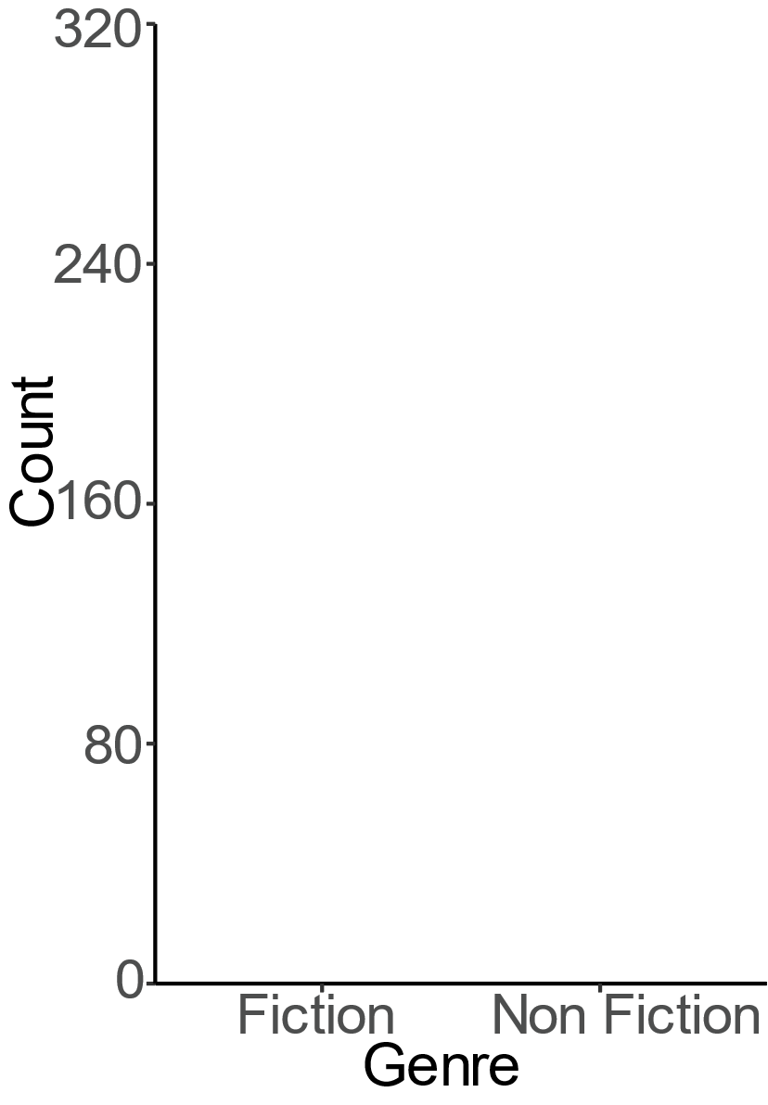

Which genre sold more unique books from 2009 – 2019?
316
234

Slide 5

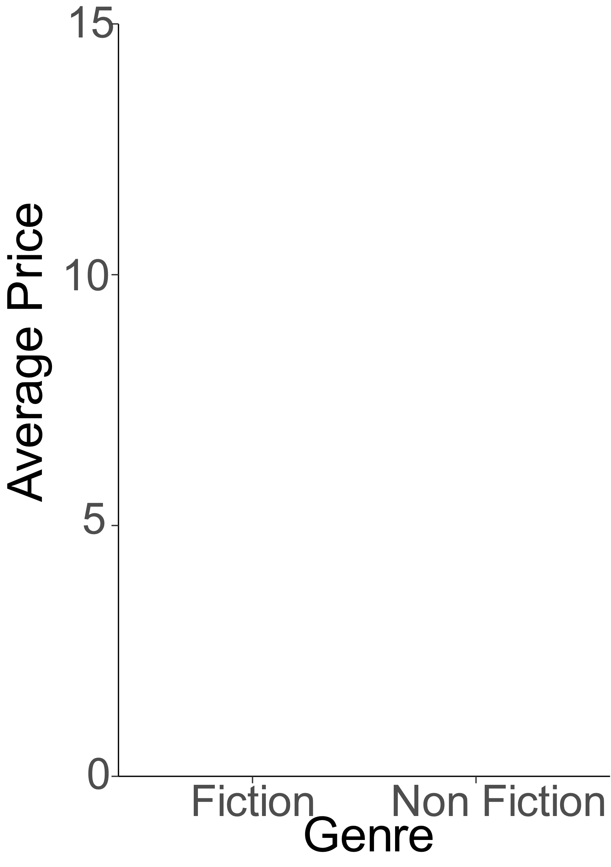

Which genre had higher pricing?
***

Slide 6
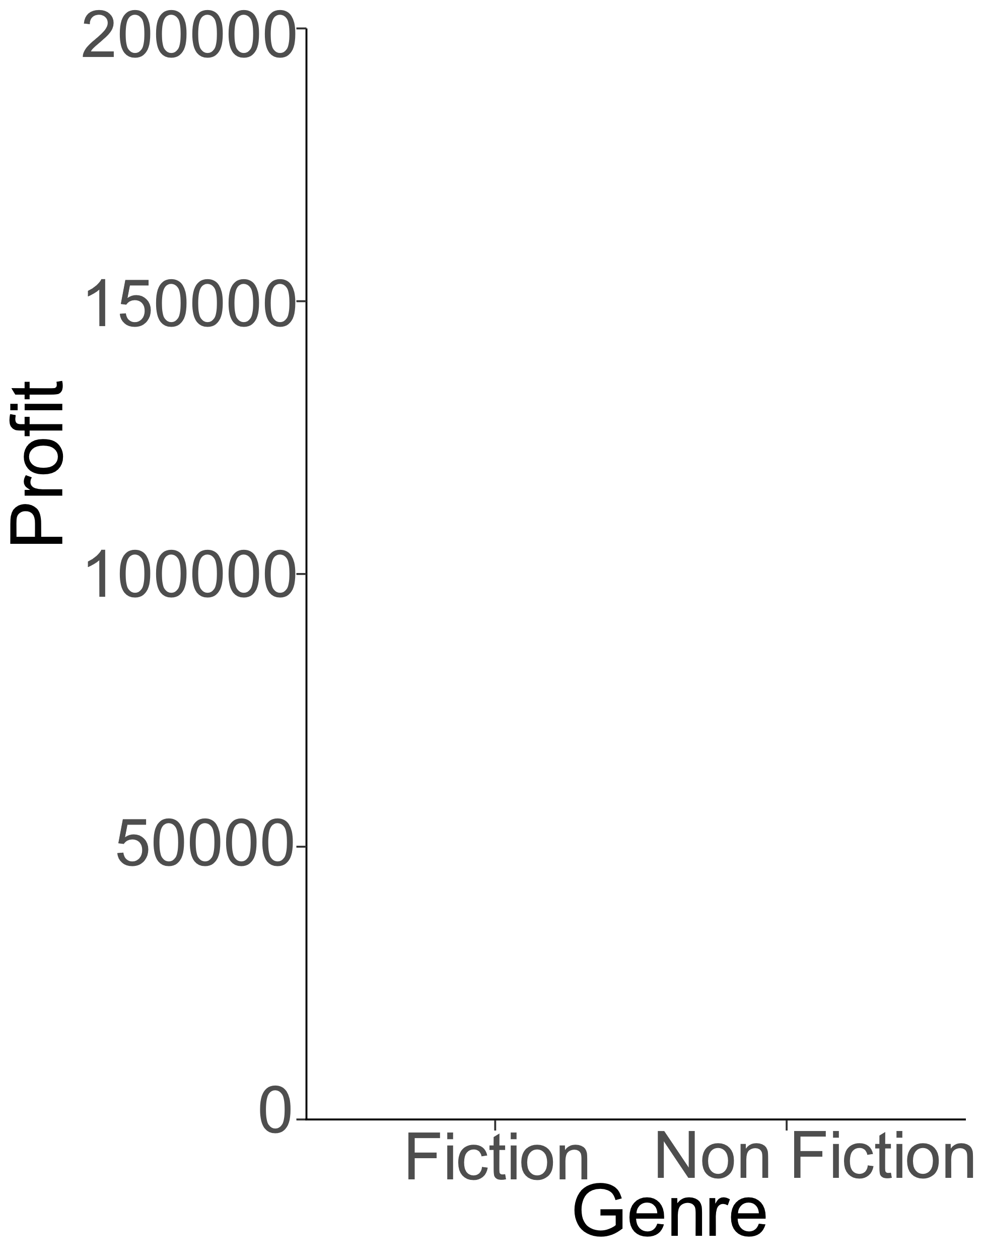


Which genre had higher overall profit?

Slide 7
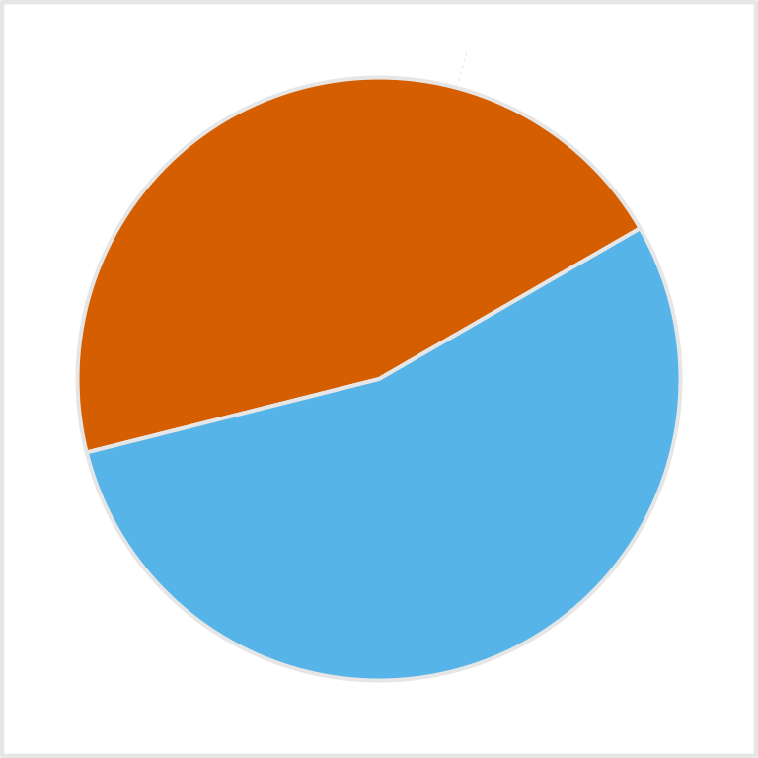
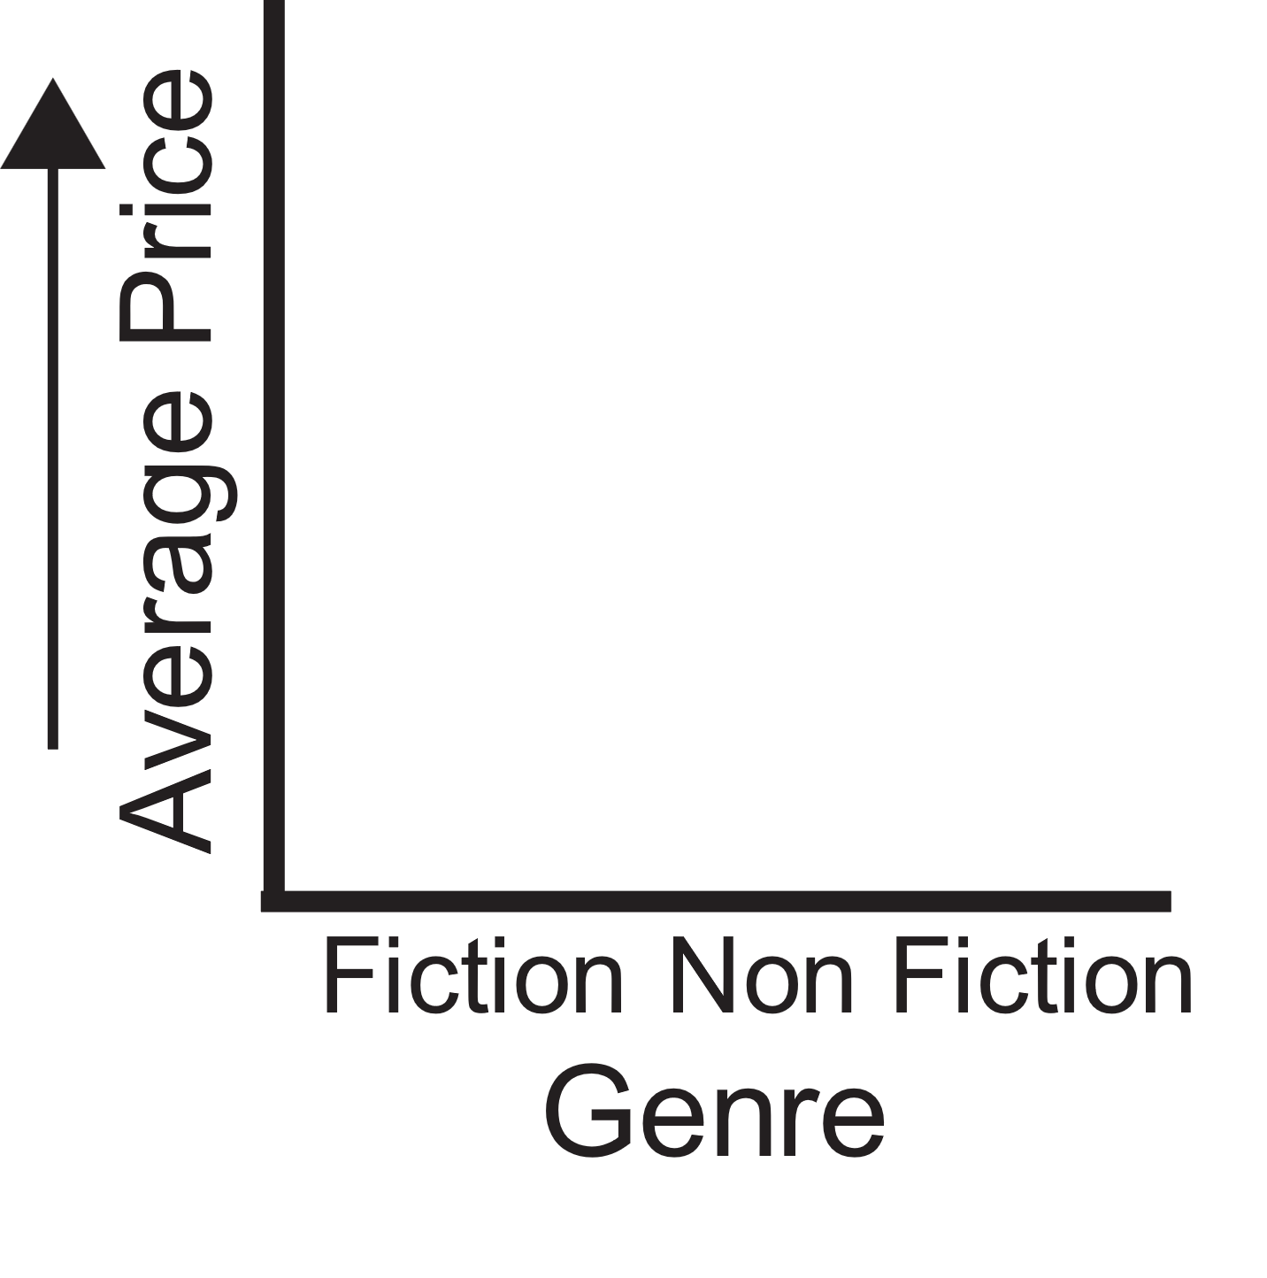
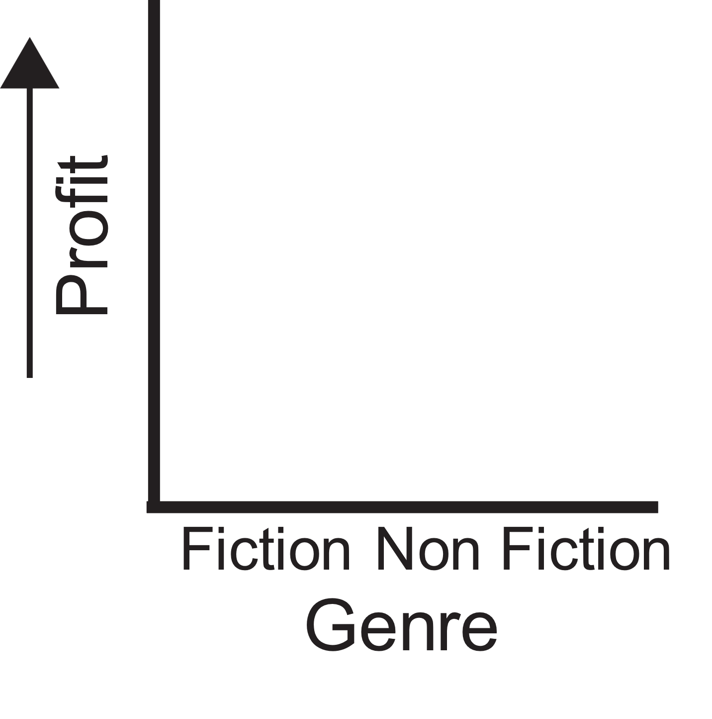



Summary of Research Question 1
Fiction
$14.5
$170k
$12
234
$110k
316
Non Fiction
Non fiction books took up a larger count of the marketplace compared to fiction books
Non fiction books on average were $2.5 more expensive than fiction books
Fiction books had a greater profit of around $60k

Slide 8
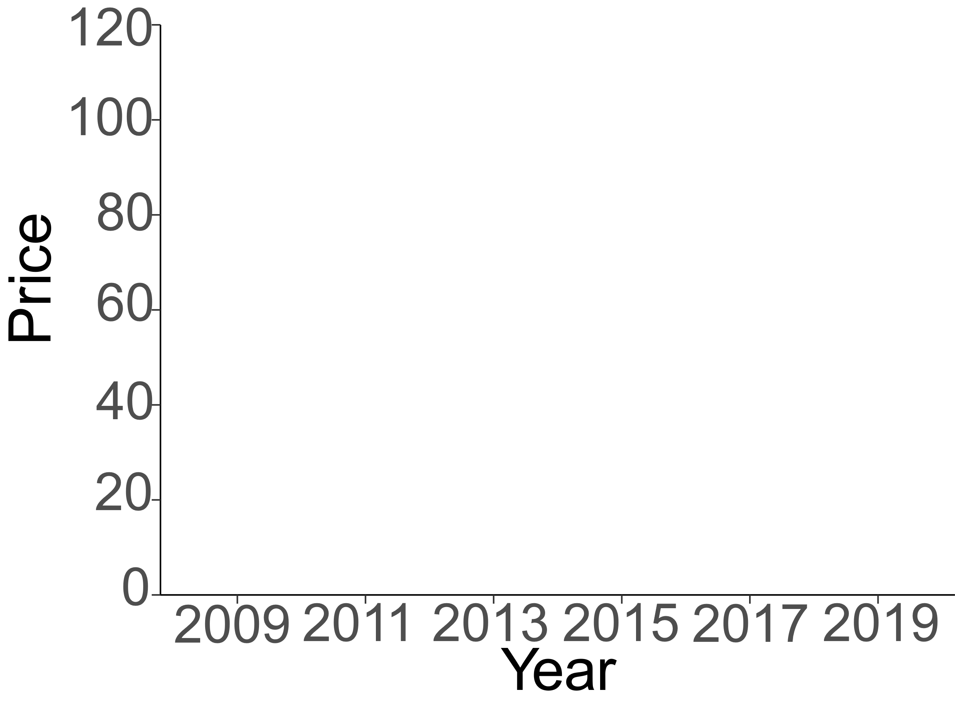
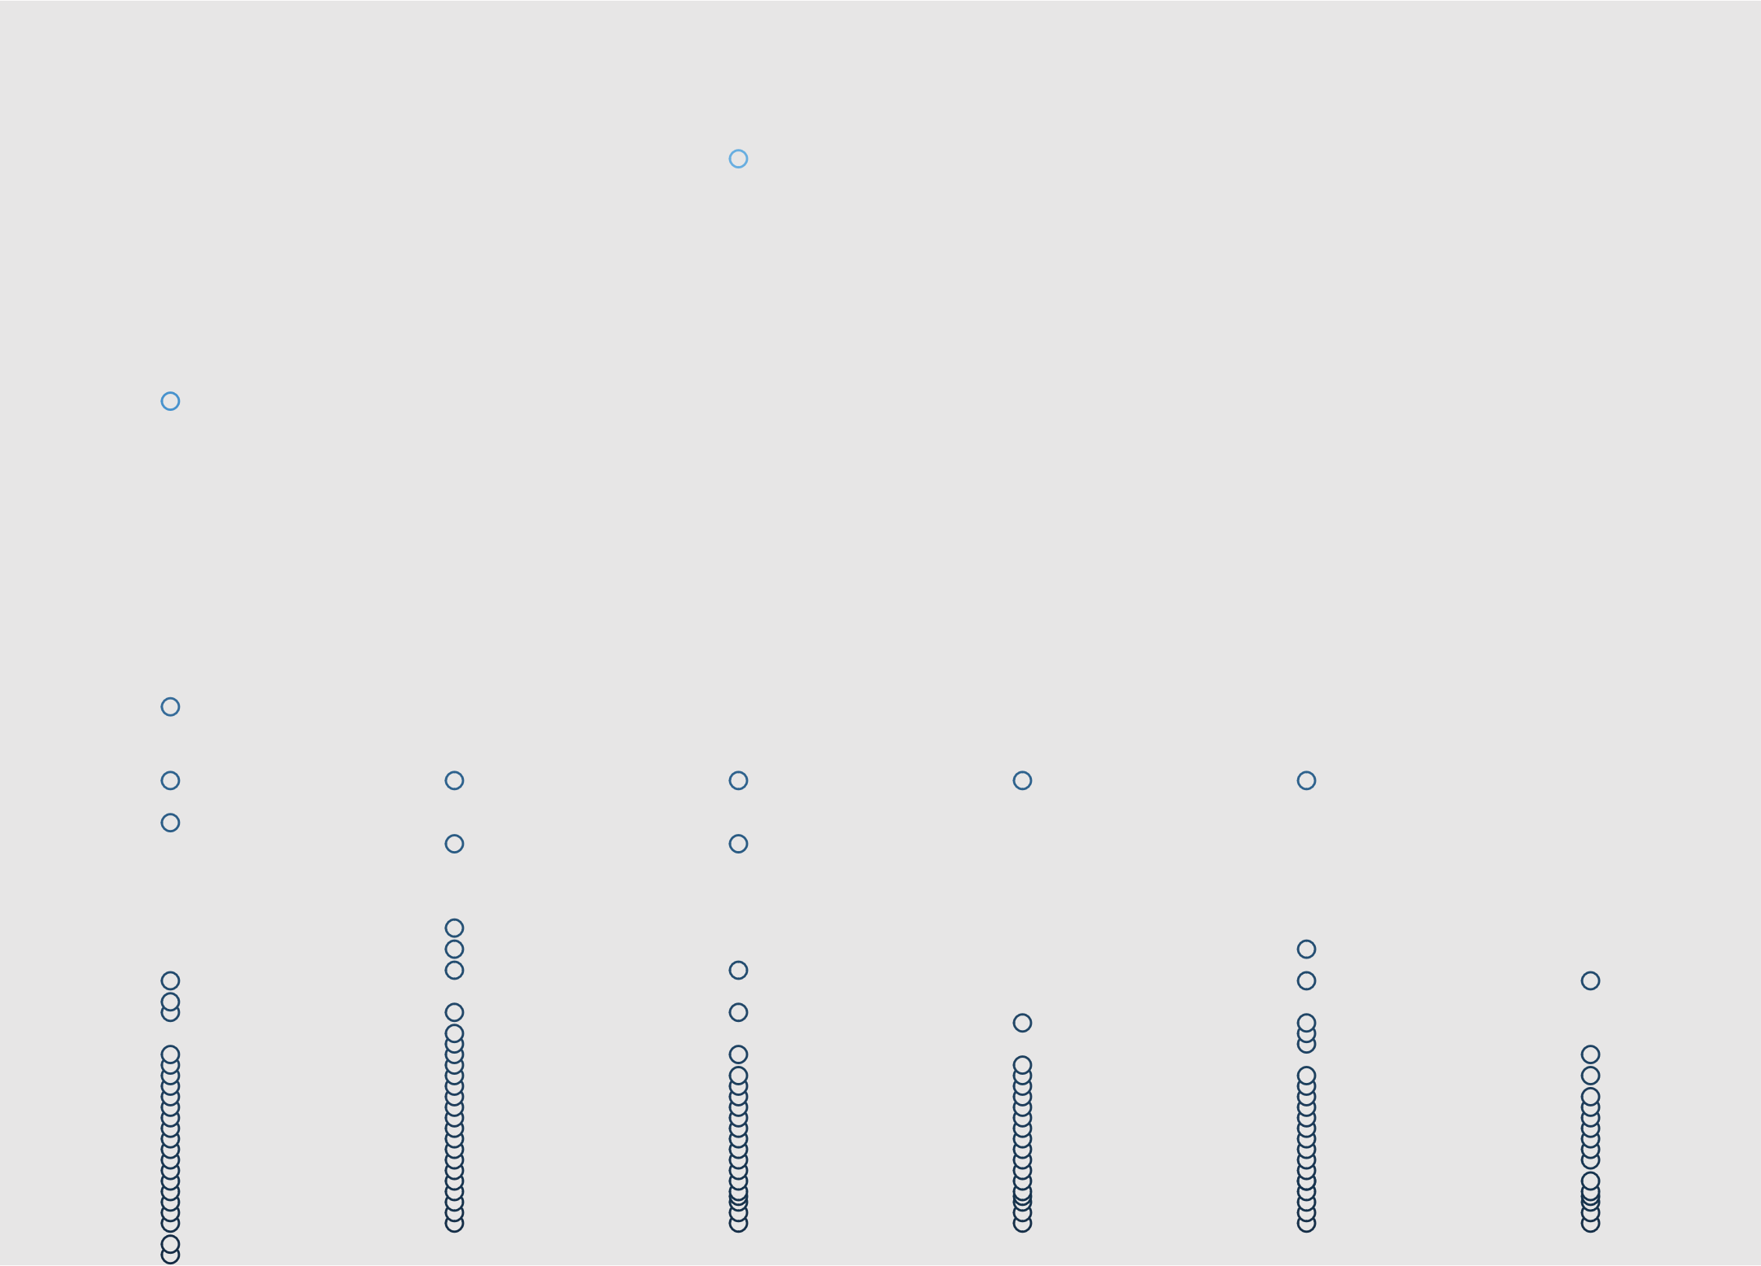
How Does Price Change Over Time?

Slide 9
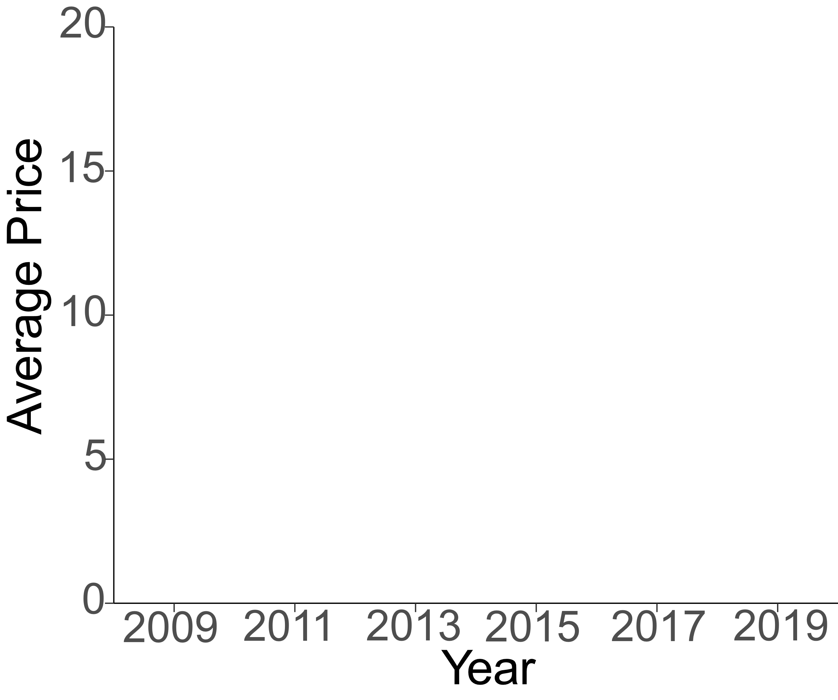

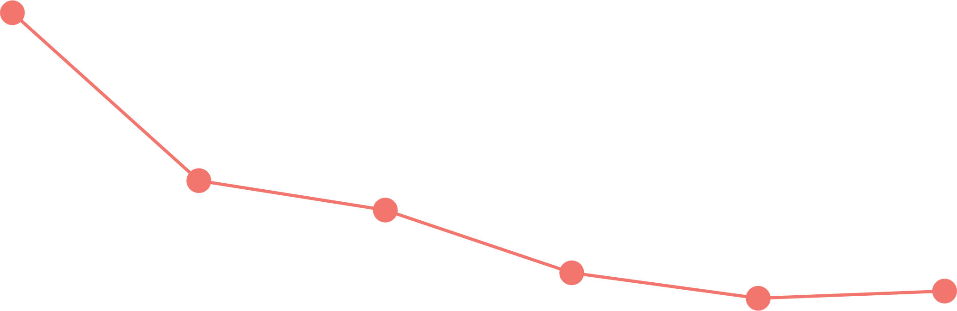
How Does Price Change Over Time for Genre?
Non Fiction
Fiction

Slide 10
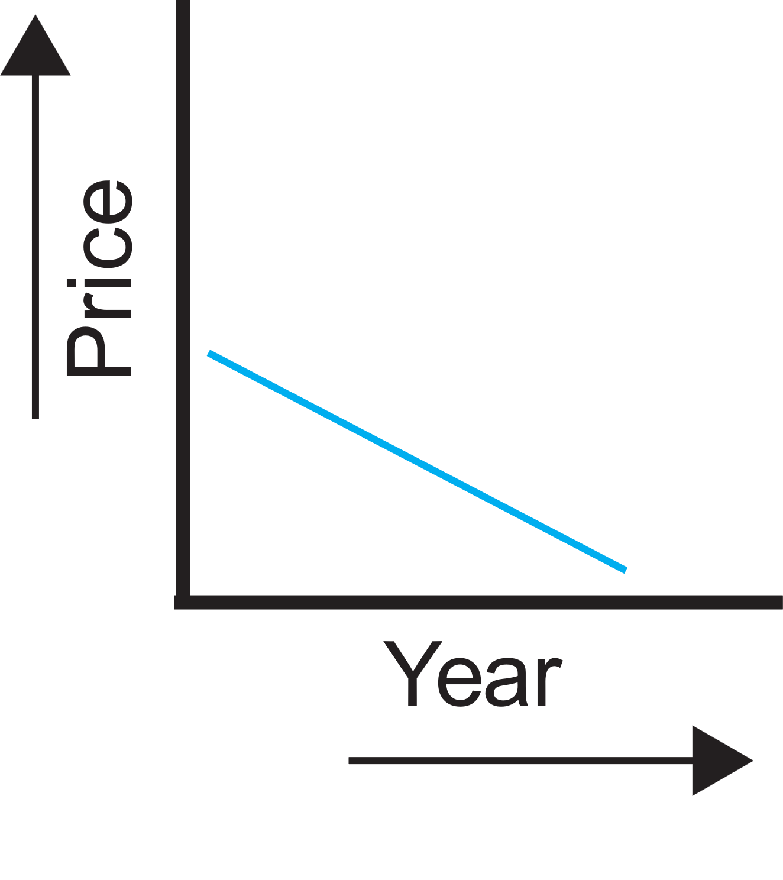
Summary of Research Question 2
There is a negative correlation between year and sale price.
The price of books has steadily declined over the years in both genres.

Slide 11


Implications and Future Directions
Future authors and publication companies should focus more on fiction books as they bring in more profit overall compared to non fiction books.
This study can be expanded to other online marketplaces and be a point of comparison in consumers’ behavior of purchasing books online?
vs
&

Slide 12



Implications and Future Directions Cont.
Future studies can look into books that are categorized as fiction and their sub-genres (e.g., science fiction & historical fiction).
Further research can be applied to sub-genres of fiction books and how they differ from one another in sale price, reviews, and ratings
Price
Reviews
Ratings
Science Fiction
Historical Fiction
vs

Slide 13
References
https://www.kaggle.com/datasets/sootersaalu/amazon-top-50-bestselling-books-2009-2019
https://bublish.com/blog/2018/03/think-like-a-reader-thursday-what-does-price-mean-to-book-buyers-in-your-genre/

